Slide 1
Git and github operation
by Deepak manohar

Slide 2
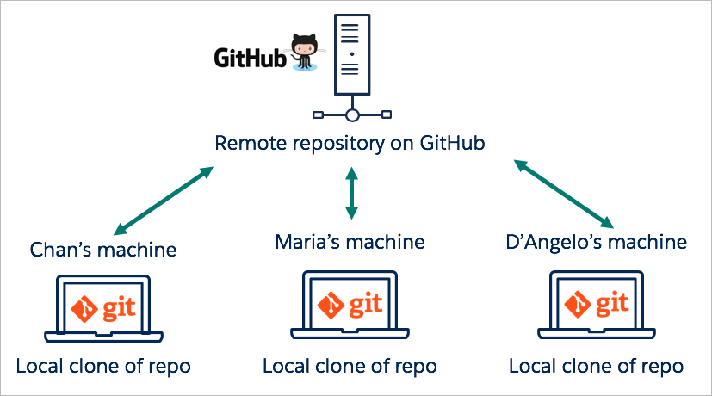
Git and GitHub

Slide 3
Index
Git vs GitHub
Workflow
Steps ( 1 - 10)

Slide 4
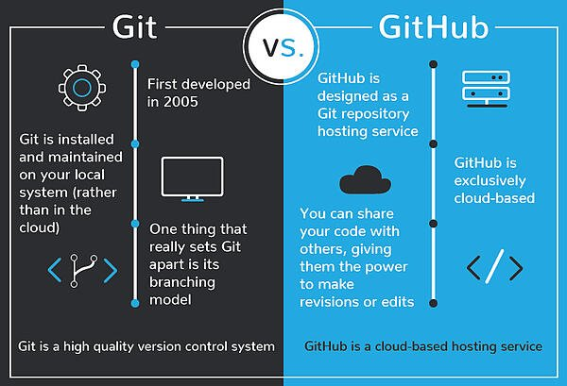
Git vs GitHub

Slide 5
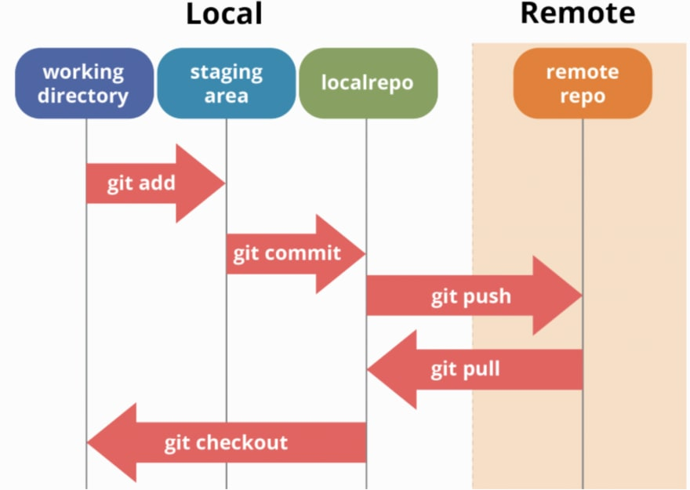
WorkFlow

Slide 6
Steps
Step 1: Install git and create a GitHub account
Step 2: Create a new repository on GitHub
Step 3: Open the path in command prompt
Step 4: Git init (check in the folder where new file .git will be created automatically)
Step 5: git add .
Step 6: git commit –m “word related to commit”
Step 7: git status
Step 8: git remote add origin https://github.com/Deepak-Manohar/ustdemo1.git
Step 9: git push –u origin master

Slide 7
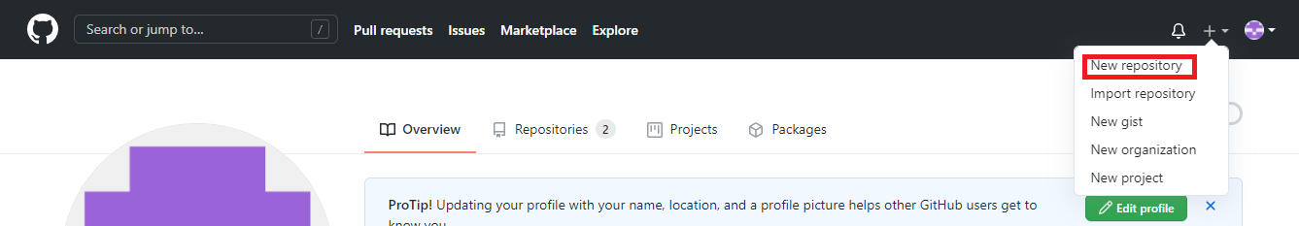
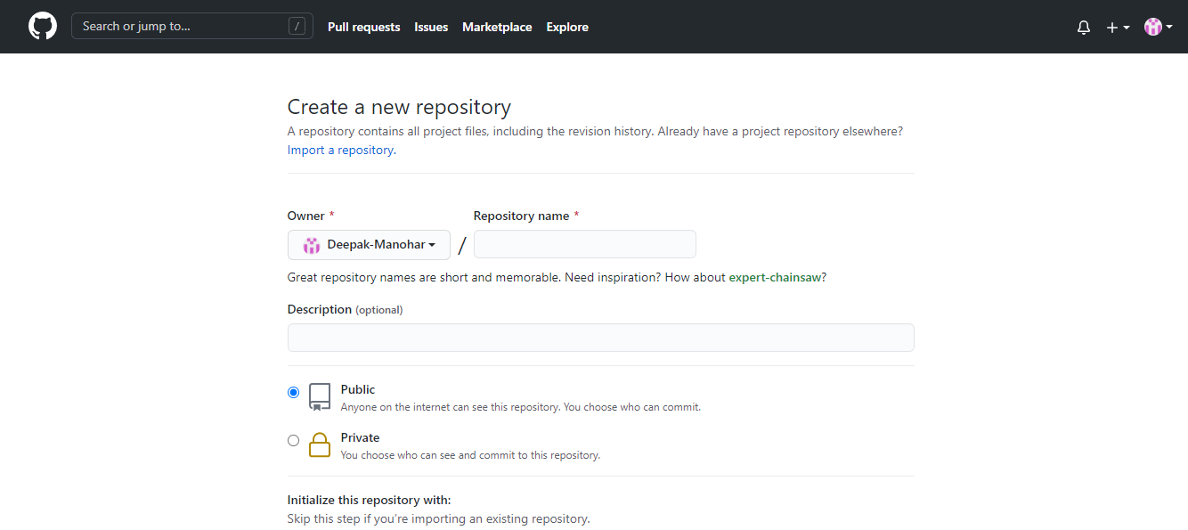
Step 2: Create a new repository on GitHub

Slide 8


Step 4: Git init Step 5: git add .

Slide 9
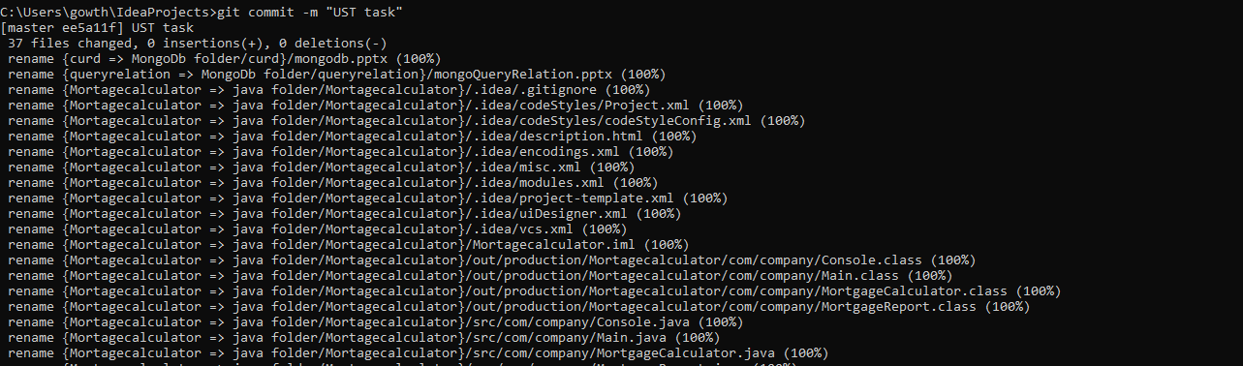

Step 6: git commit –m “word related to commit” Step 7: git status

Slide 10
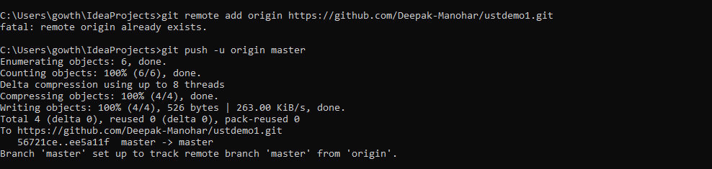
Step 8: git remote add .. Step 9: git push –u origin master

Slide 11
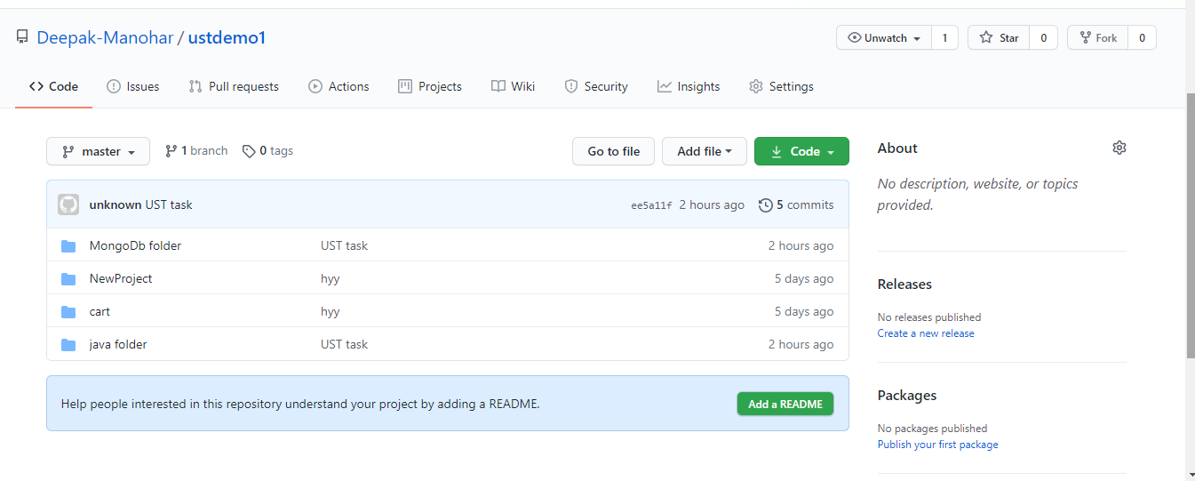
View the folder in GitHub

